Slide 1

Driver Drowsiness Detection
Industry project- iipr
Name – Aditya Chaudhry – 18csu011
Aman Sharma – 18csu015
Deepanshu Gandhi – 18csu059
Devesh Bhatia – 18csu061

Slide 2
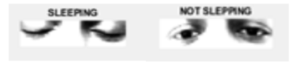
Overview - Drowsiness Detection System
Driver drowsiness detection is one of the best method which can be used to alert a person if he/she gets a bit drowsy. As per reports, falling asleep during driving and losing control of vehicle is one of the top factors in fatal accidents, that has caused a loss of life, money, and public property.
This accident can easily be avoided by using advanced alert systems like this, which are designed using core machine learning and deep learning models along with special techniques like transfer learning, which not only help alert the driver but with time also learn the pattern of driver’s activity and gets more accurate.
Brands like Volkswagen, audi, bmw, volvo have already started implementing this technique in their high spec models to avoid such a dire situation. Though their systems are good, but a lot of work can be done to further improve the systems by applying algorithms of machine learning paired with best features of transfer learning, to allow the system to learn patterns and become more effective.

Slide 3
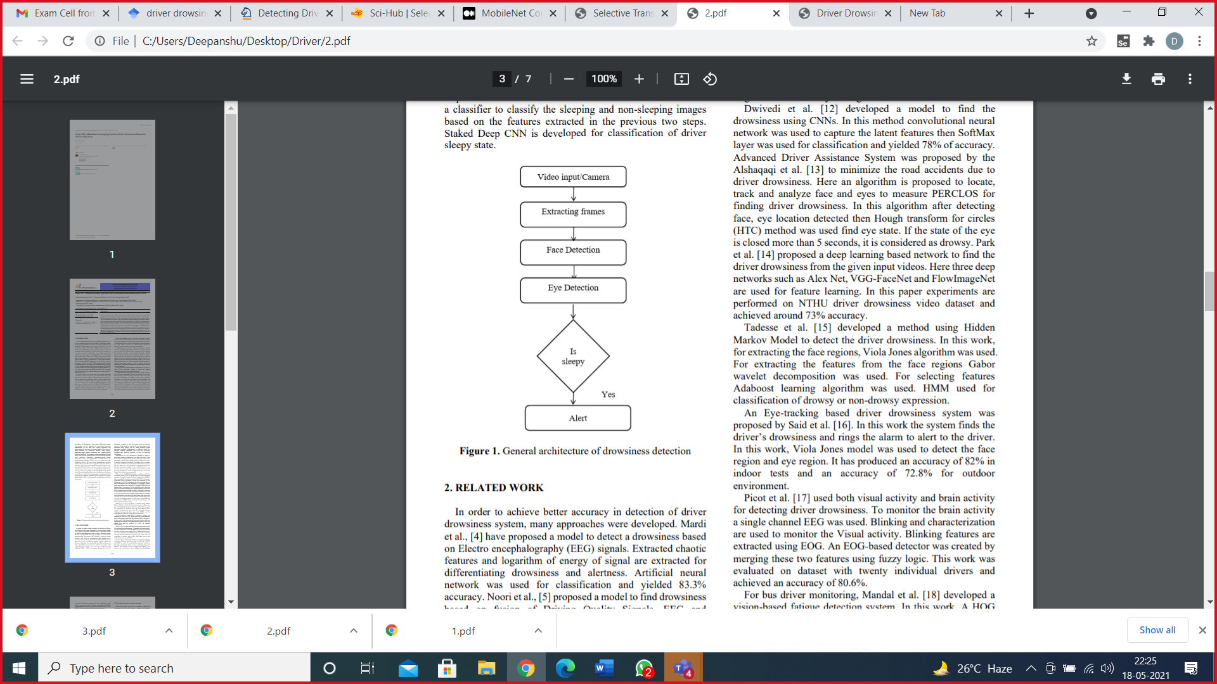
Framework/Overlook
The framework is built using deep learning to detect drowsiness based on eye state, to detect the face and extract eye region from facial images. A transfer learning technique is applied to extract effective abstract eye features and improve the classification capability of the proposed model on small sample datasets.
The proposed methodology treats drowsiness detection as an object detection task, and from an incoming video stream of a driver, detects and localizes open and closed eyes. MobileNet CNN architecture with Single Shot Multibox Detector (SSD) is used for this task of object detection followed by using separate algorithm to detect driver drowsiness based on the output from MobileNet-SSD architecture.
To train the MobileNet-SSD Network a custom dataset of about 10,000 images is compiled and labeled with the objects face, eye [open and closed] and among these, 2000 images are randomly separated and used to test the trained model, to add more it can process an incoming video stream in real time on a standalone mobile device without the need of expensive hardware support as a result reasonable accuracy, computational efficiency and cost effectiveness is maintained.

Slide 4
Methodology
Now-a-days, many people use automobiles for daily commutation, which leads to high volumes of traffic on road which in turn inc the probability of road accidents with several factors, feeling sleepy could be one of reason for road accidents.
In the first step, we identify the face regions from the input images, for a human face detection task is easier, but this task is difficult in computer vision. Face detection techniques are classified into feature-based techniques and image-based techniques. Statistical, Neural Networks and Liner subspace methods have been used by the Image-based approaches for face detection.
In the second step, different eye region detection algorithms are used to detect and extract the eye region from the face images. The contrast differences among face images is adjusted by performing histogram equalization.
In the third step, feature extraction is implemented on the input eye region images. There are two main methods for extracting features from images: appearance-based feature extraction and geometric-based extraction methods. In this context we’ve used appearance-based technique.

Slide 5
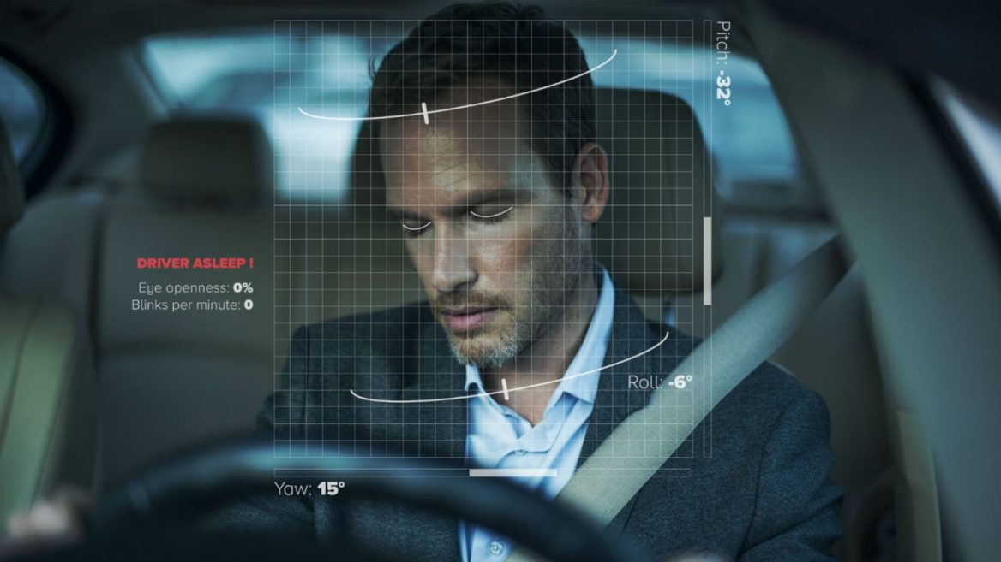
Requirements/Technique
Dataset: - our dataset contains infrared images in low and high resolution, which are captured in various lightning conditions and by different devices. In order to simplify the comparison of algorithms, the images are divided into several categories, which also makes them suitable for training and testing classifiers. The Dataset contains around 10,000 images in which we use 2000 images for training. Also, data is categorized into open and closed eyes in different folders.
Transfer Learning: - is a well-known Deep Neural Network technique where a pre-trained neural network is used to solve a problem that is similar to the problem the network was initially trained to solve. Transfer learning is a commonly used technique with deep learning as it can overcome many problems associated with deep neural. Using transfer learning can reduce the training time, reduce efforts of tuning many hyperparameters, and above all increase the accuracy and performance every time model is executed.

Slide 6
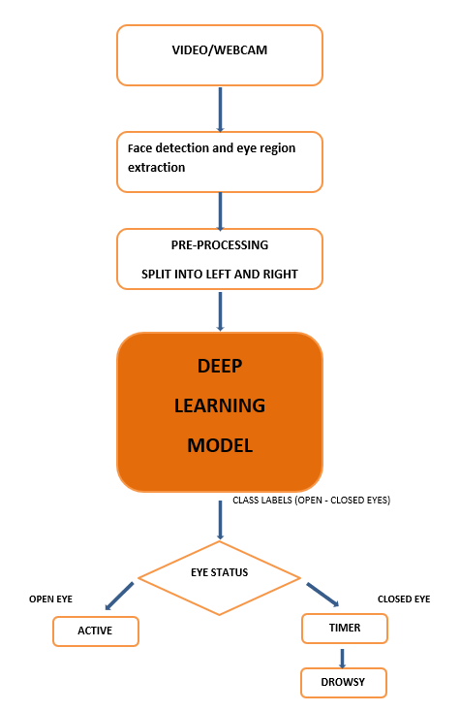
Architecture
The proposed architecture of Drowsiness detection system is -
1. Deep CNN
The proposed model has five phases -
1. Video/webcam
2. Feature extraction
3. Pre-processing
4. CNN MobileNet Classifier Deep Learning model
5. Eye status: - 5.1 open eye 5.2 closed eye.

Slide 7
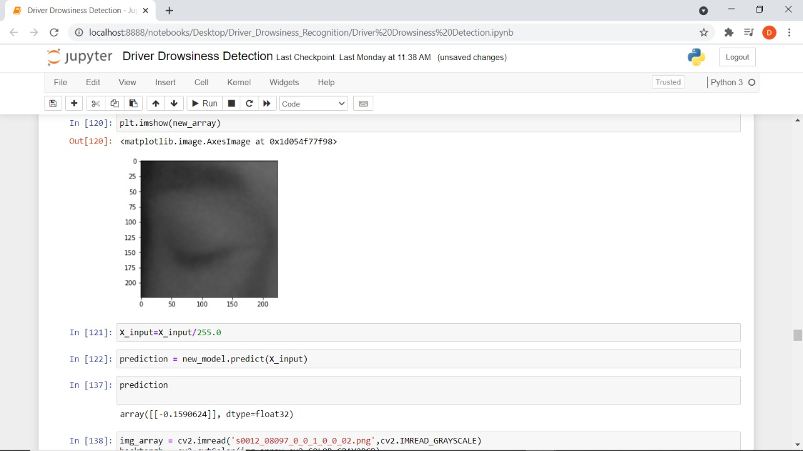
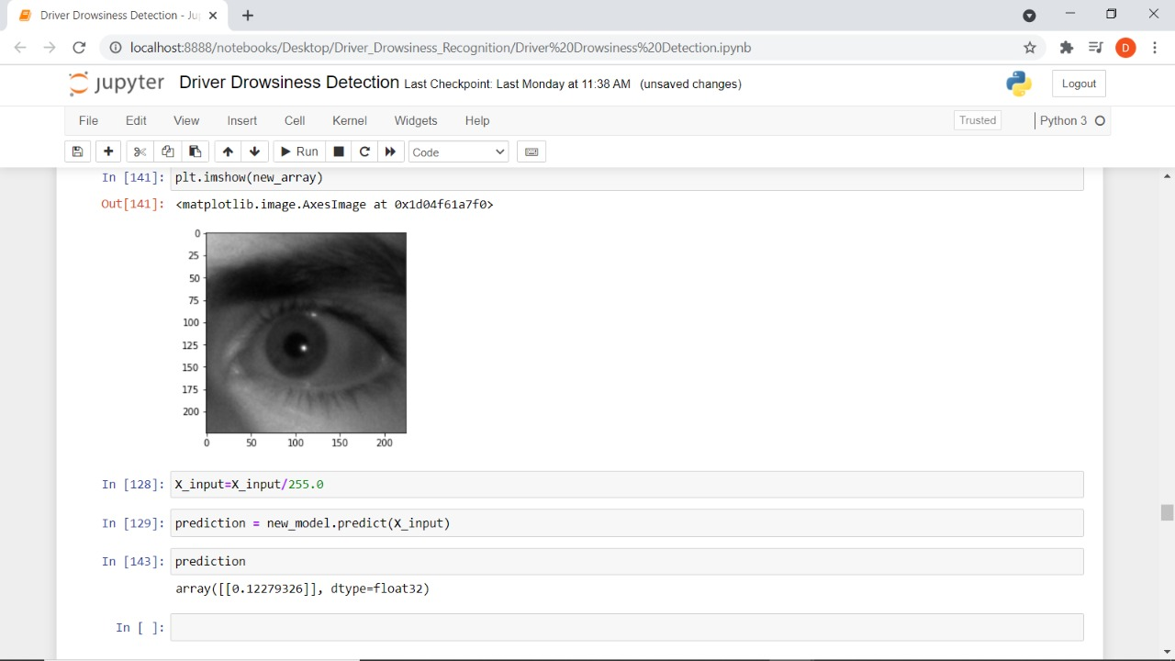
Result/Outcome
Case 1:- captured eye images pass to our model checking for prediction If a driver's eye keeps close for 3 to 4 seconds it is believed that driver is drowsy shown by numpy array by negative indexing.
Case 2:- captured eye image pass to our model checking for prediction If a driver’s eye keeps open Or less blinking rate that means driver in active state (not drowsy) shown by positive indexing .

Slide 8
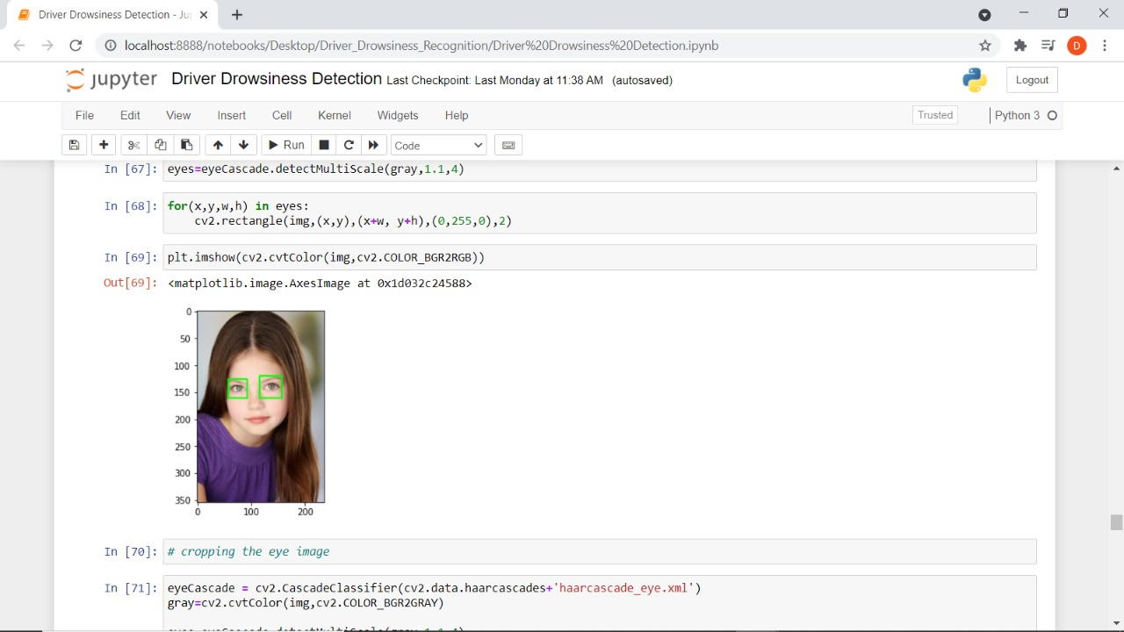
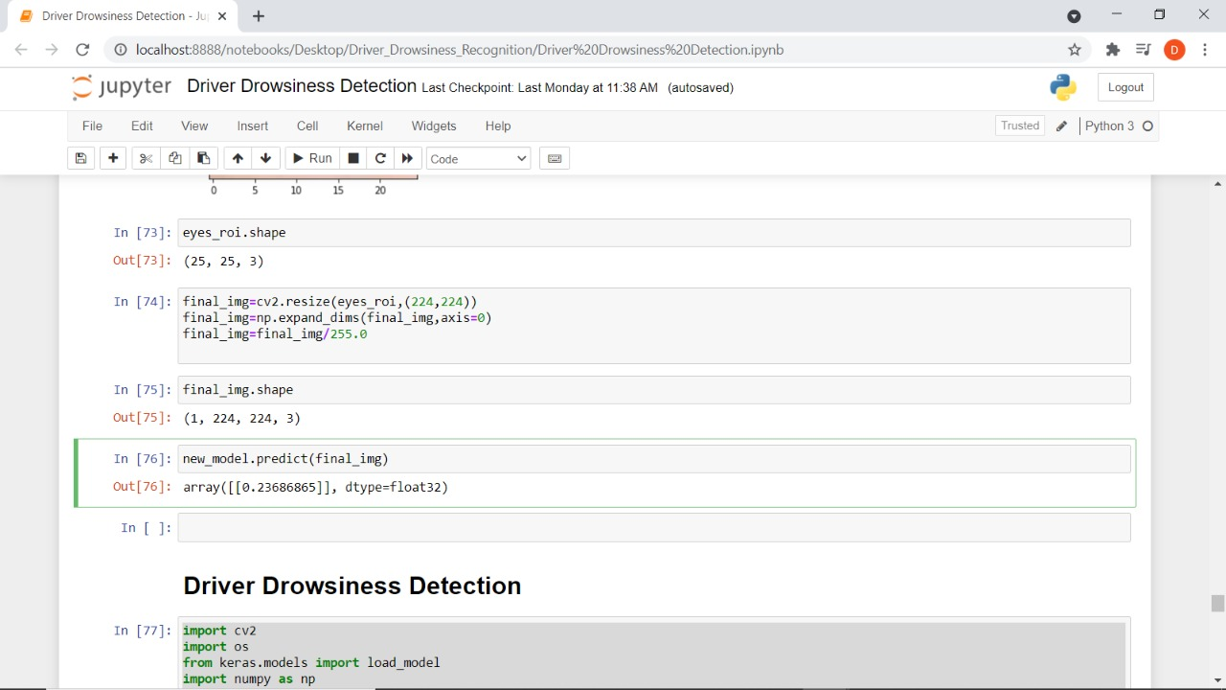
Result/Outcome
Case 3:- Captured Face images pass to our model Firstly Face detection and eye region extraction technique apply of our image this extracted eye image check If a driver eye keep open then numpy array pass positive indexing value otherwise driver eye keep closed then numpy array pass negative indexing value.

Slide 9
Conclusion/Future Prospects
We conclude that fatal accidents can be avoided by using such advanced systems, which help regain consciousness within time. Technique used include, eye closure time and total eye blink (greater than 3 second based on the facial landmark). Eye closure time was used to compare with a standard value in normal physical condition. The total eye blink per minute is recorded then compared according to the different time of day. If any of the above methods is unsatisfied then the system decides the driver is unconscious.
In the future, we look forward to integrating this system into an android app to make it easily accessible for all. Then the complexity of implementation will be alleviated, and it will be portable. Also, paired with a portable IR camera it will be possible to run the system at night times also.

Slide 10

This Photo by Unknown Author is licensed under CC BY-SA

